Slide 1

Data Warehouse Design and ETL Implementation Using Informatica
By Sagar Jamuar

Slide 2
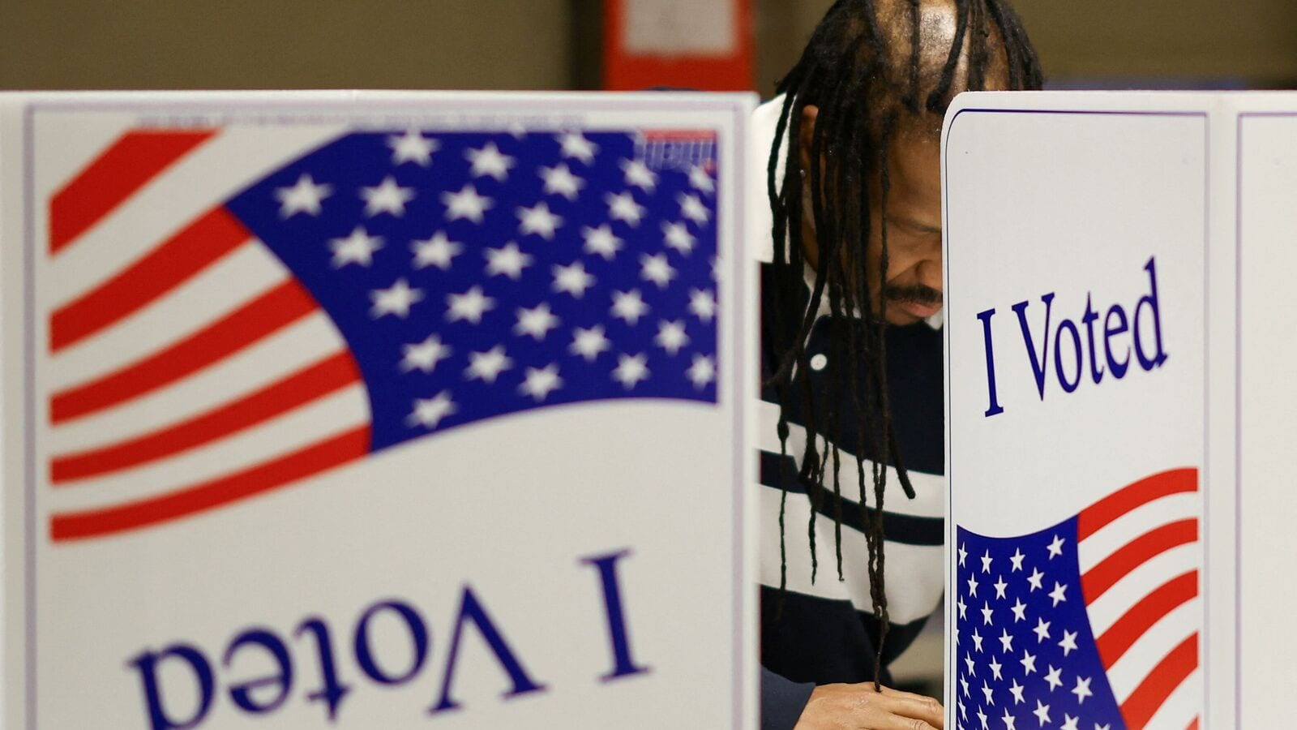
US ELECTION DATA 2016
StateCode: Two-letter code representing each state (e.g., AK for Alaska).
StateName: Full state name.
CountyFips: Unique numeric code identifying counties.
CountyName: Name of the county (e.g., Alaska, Macon).
CountyTotalVote: Total votes cast in the county.
Party: Political party associated with the candidate (e.g., GOP).
Candidate: Candidate's name (e.g., Trump).
VoteCount: Total votes received by the candidate in the county.
The dataset provides a granular view of election results by county.
Enables analysis of voting patterns by state, party, and candidate.

Slide 3
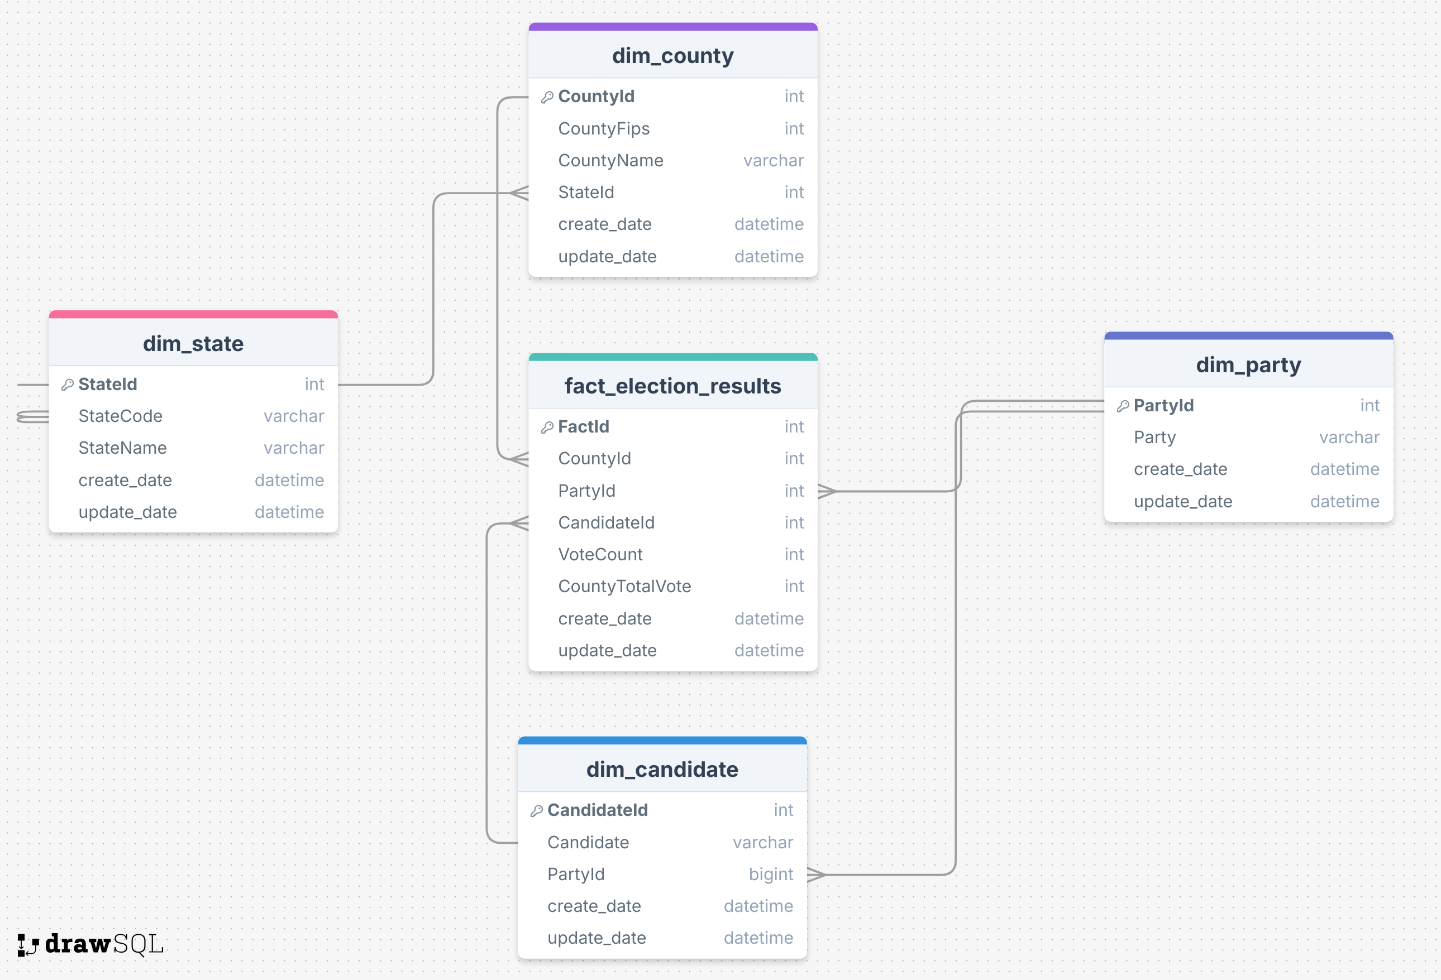
Dimensions and facts

Slide 4
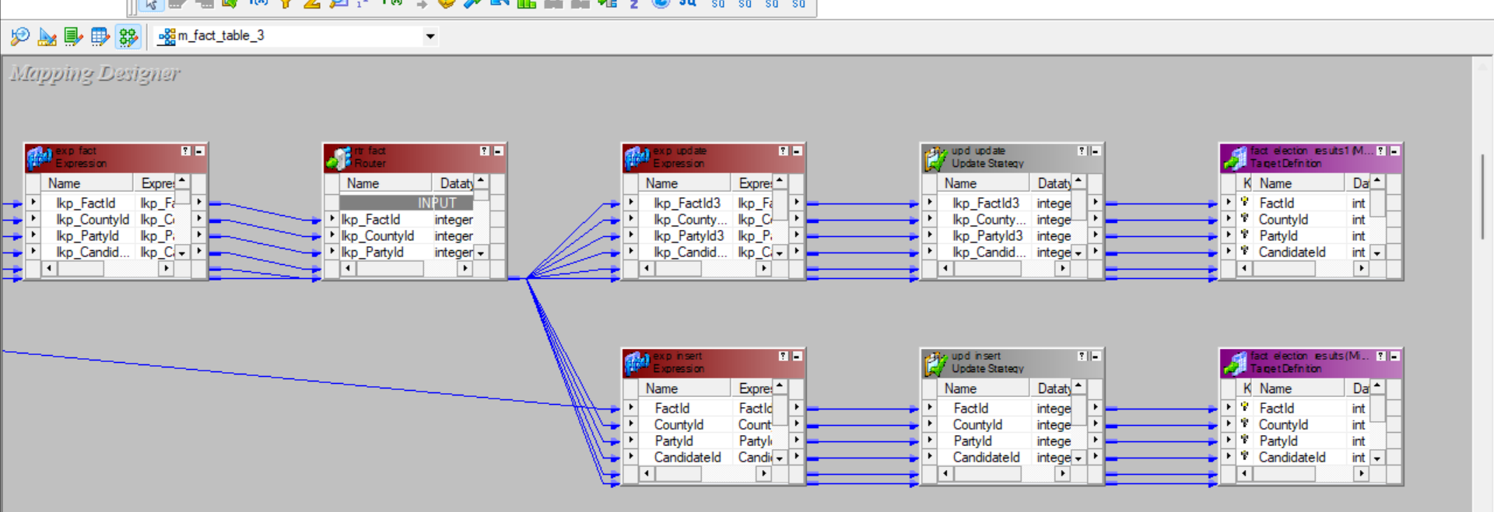
Data warehouse loading strategy – SCD1 (SLOWLY CHANGING DIMENSION)

Slide 5
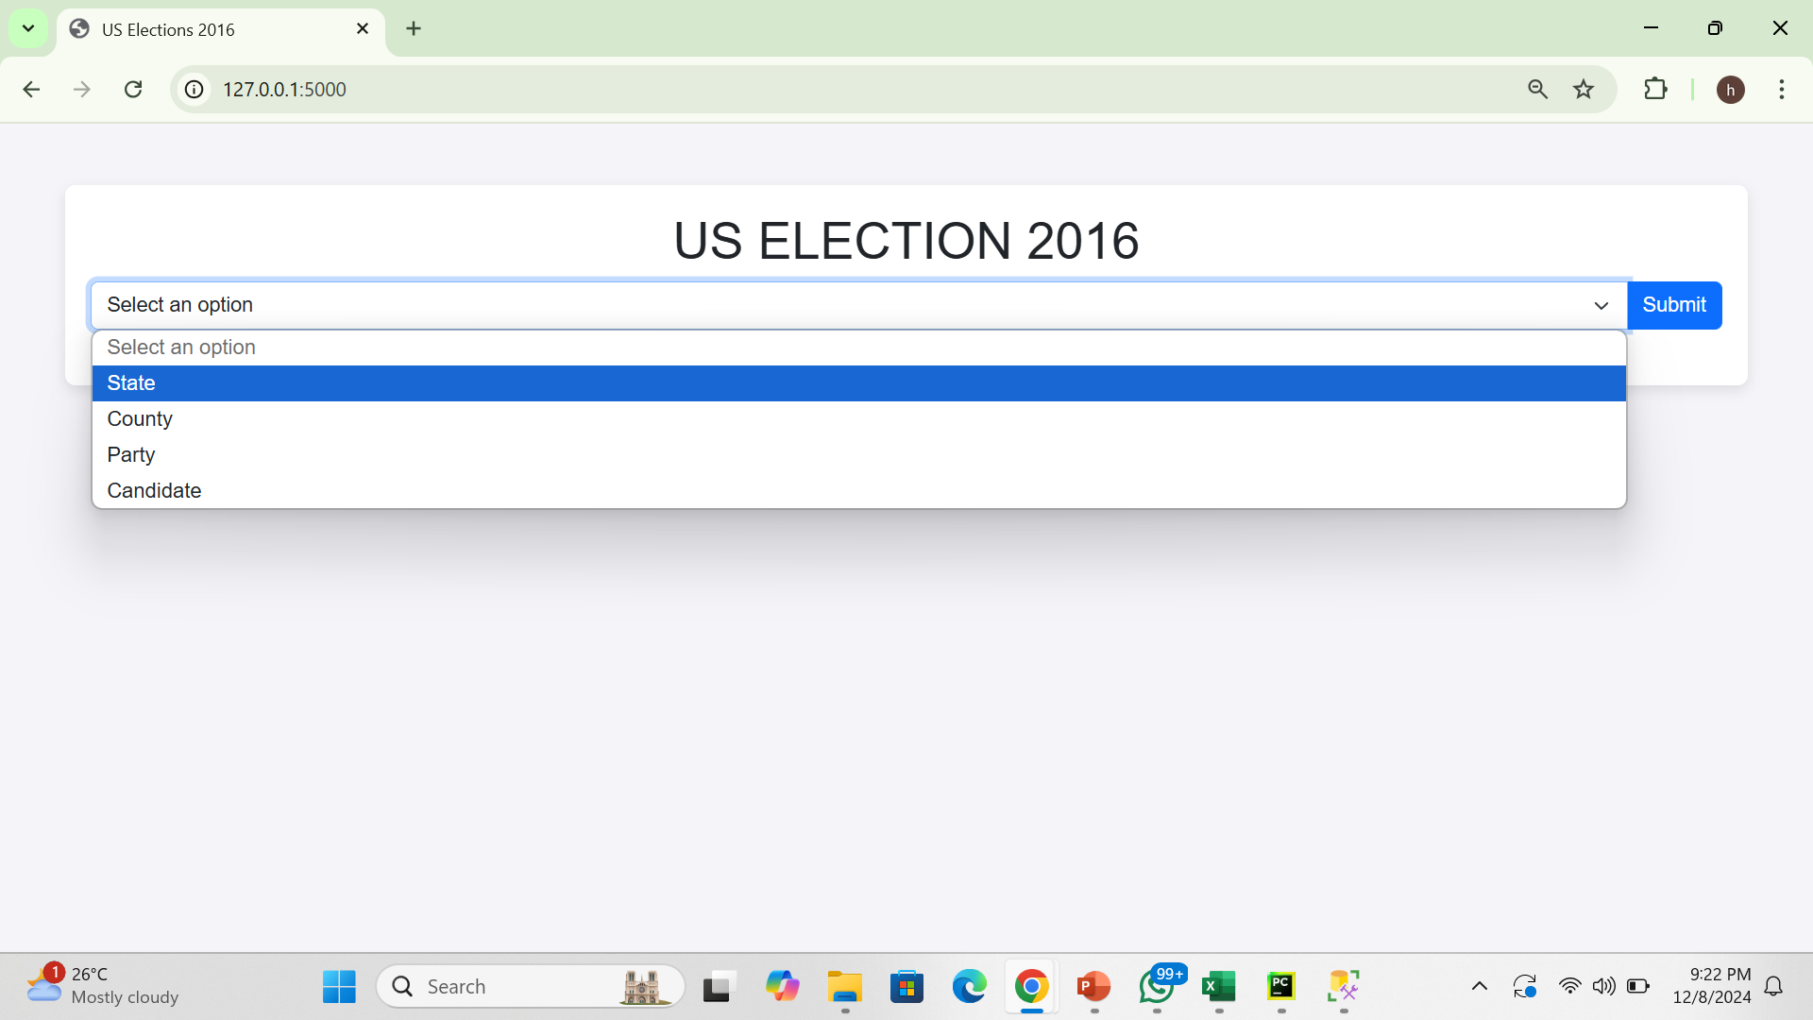
Flask UI for different types of visualizations

Slide 6
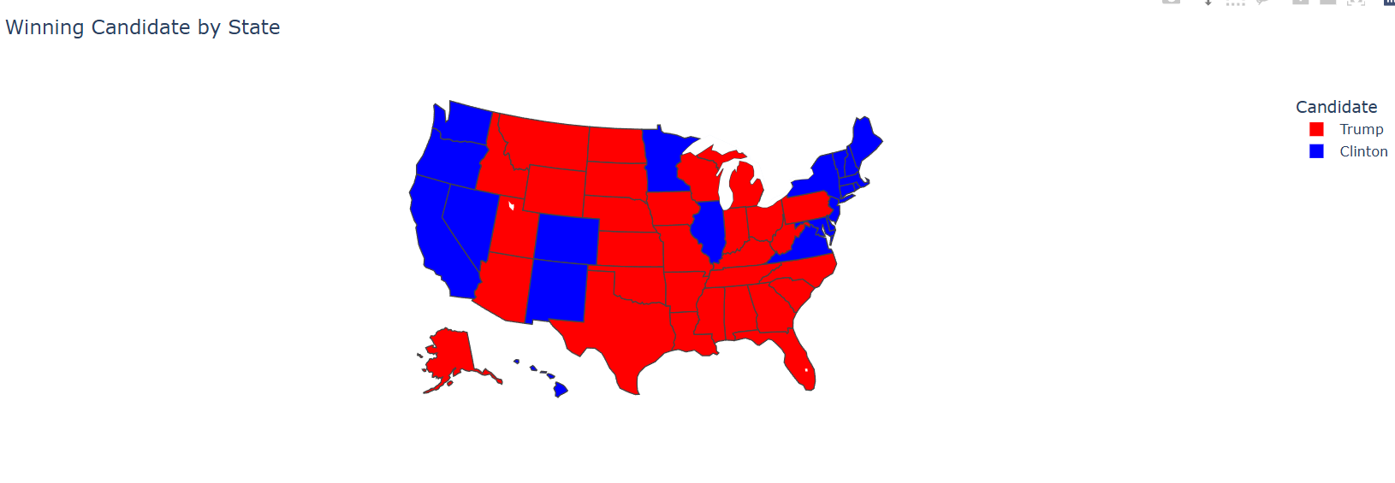

Slide 7
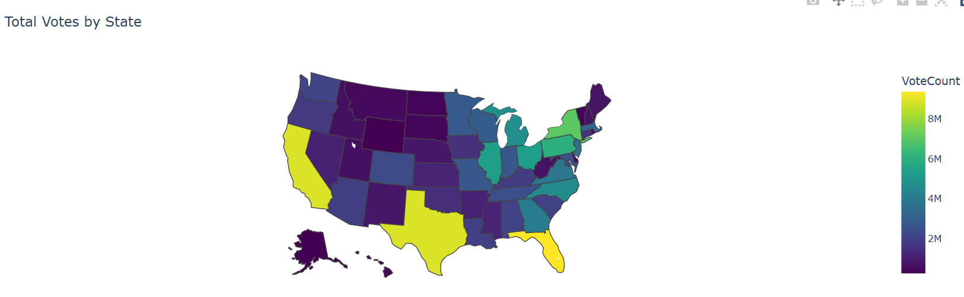

Slide 8
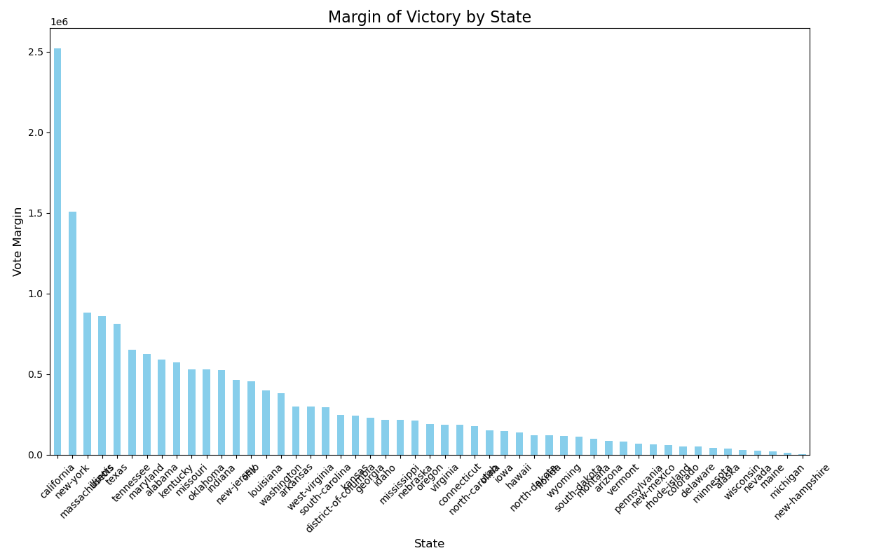

Slide 9
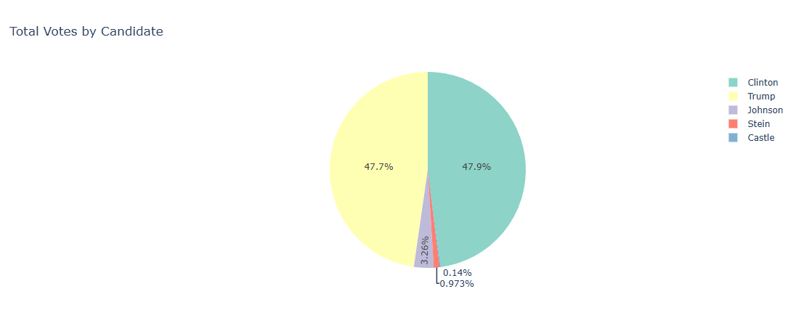

Slide 10
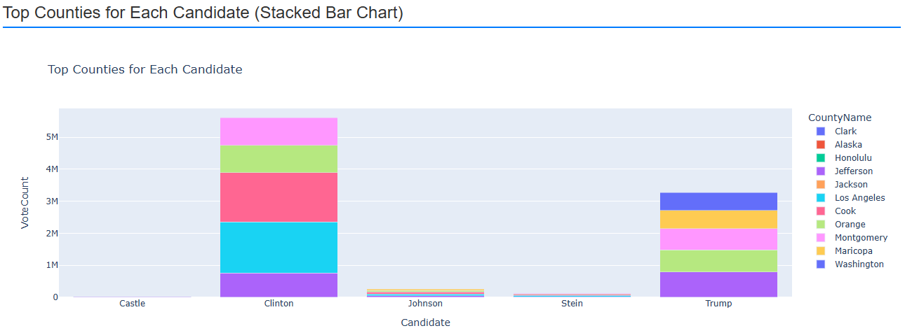

Slide 11
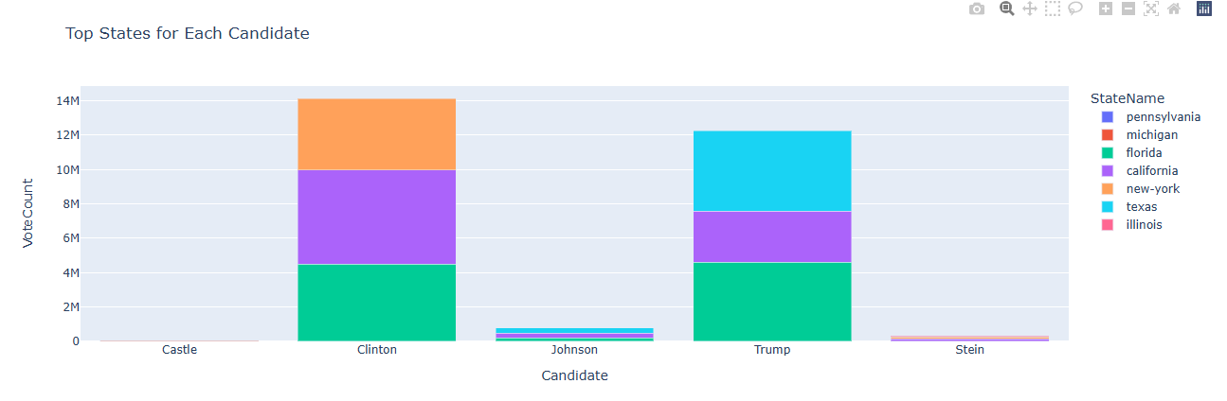

Slide 12
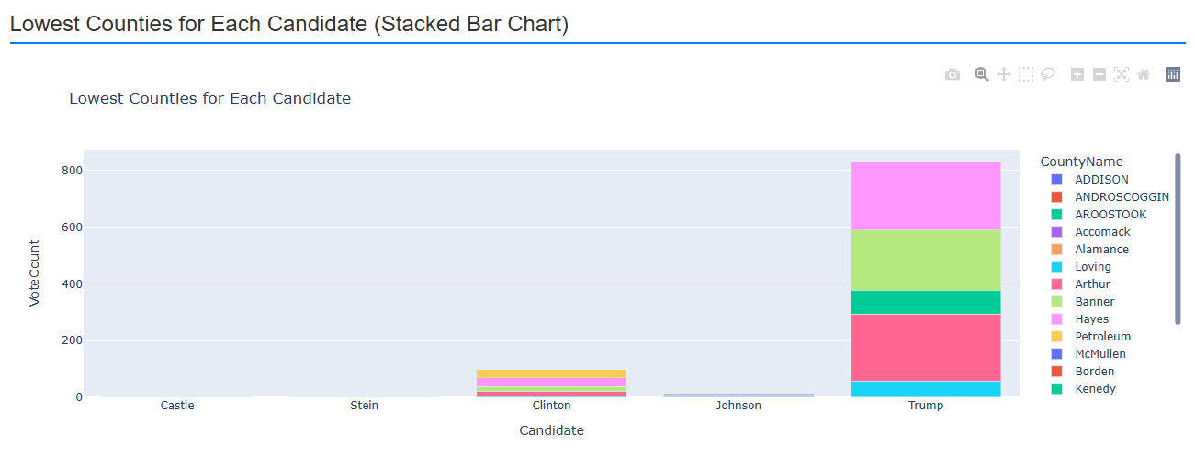

Slide 13
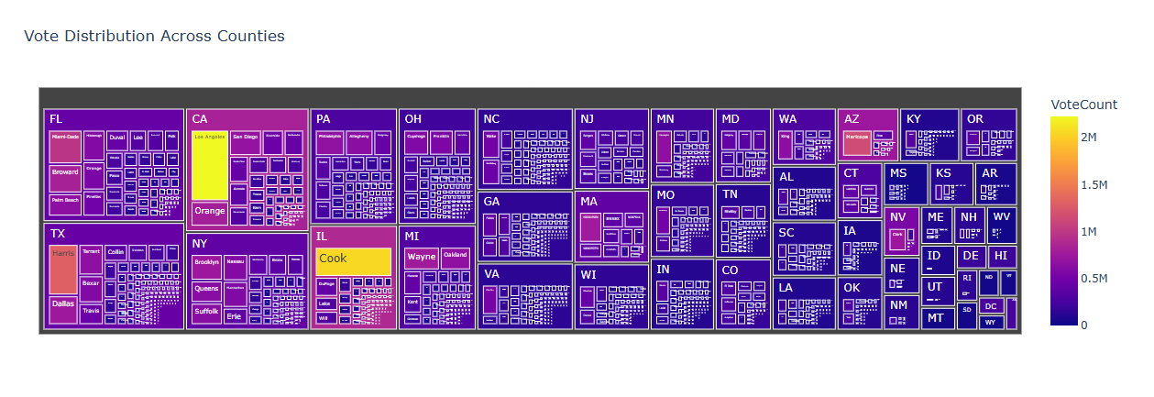

Slide 14
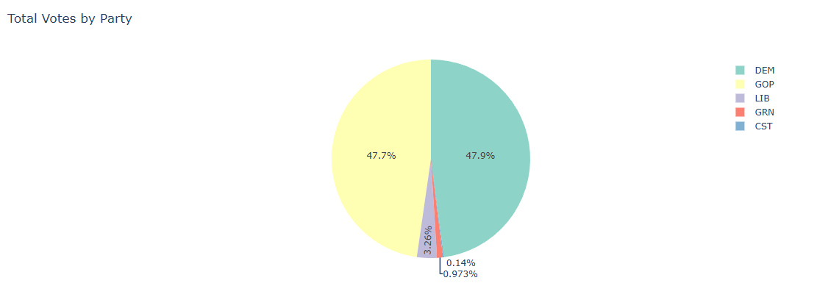

Slide 15
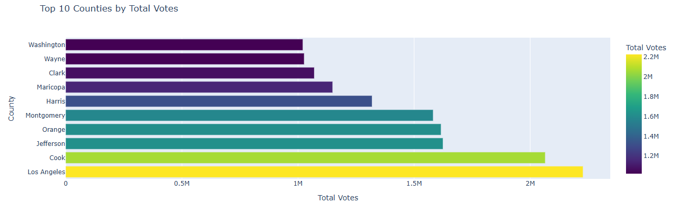

Slide 16
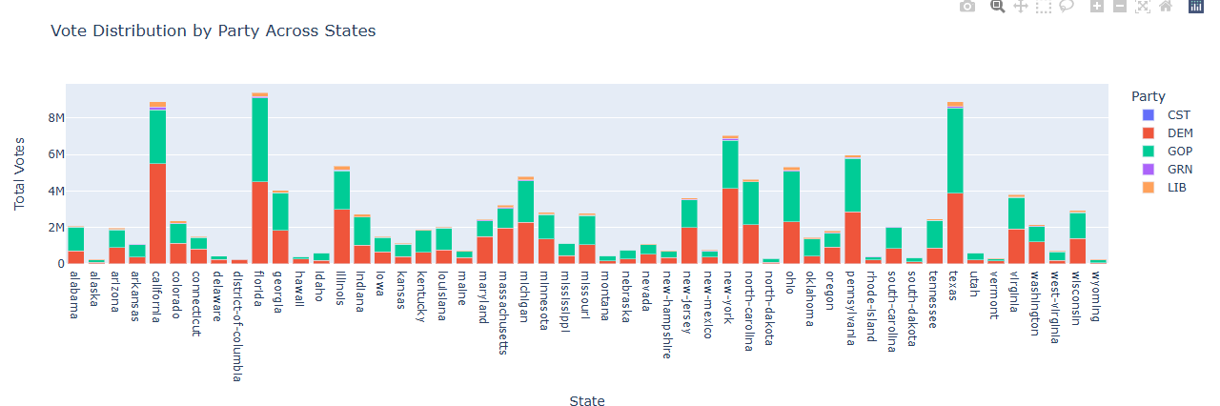

Slide 17
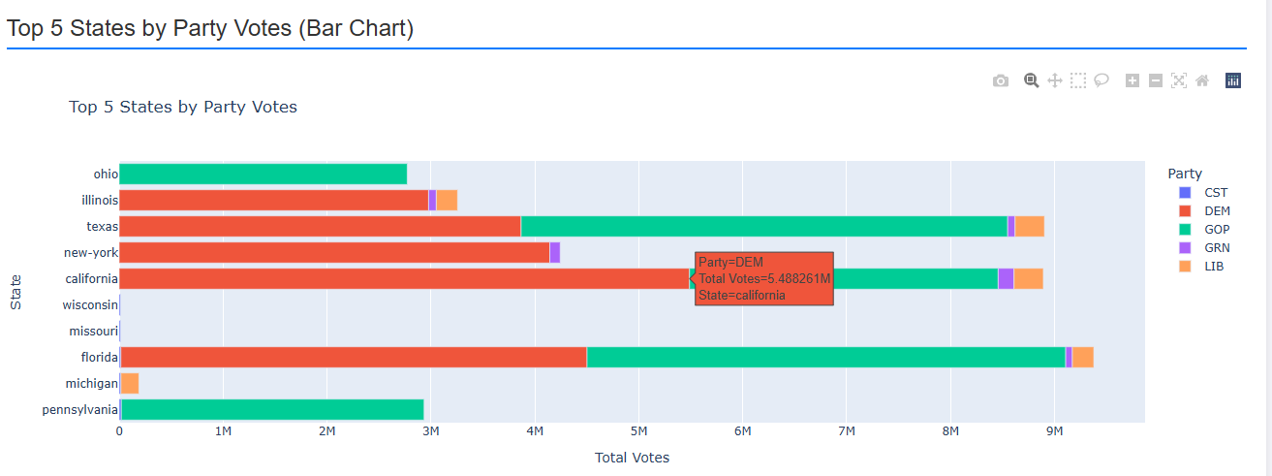

Slide 18
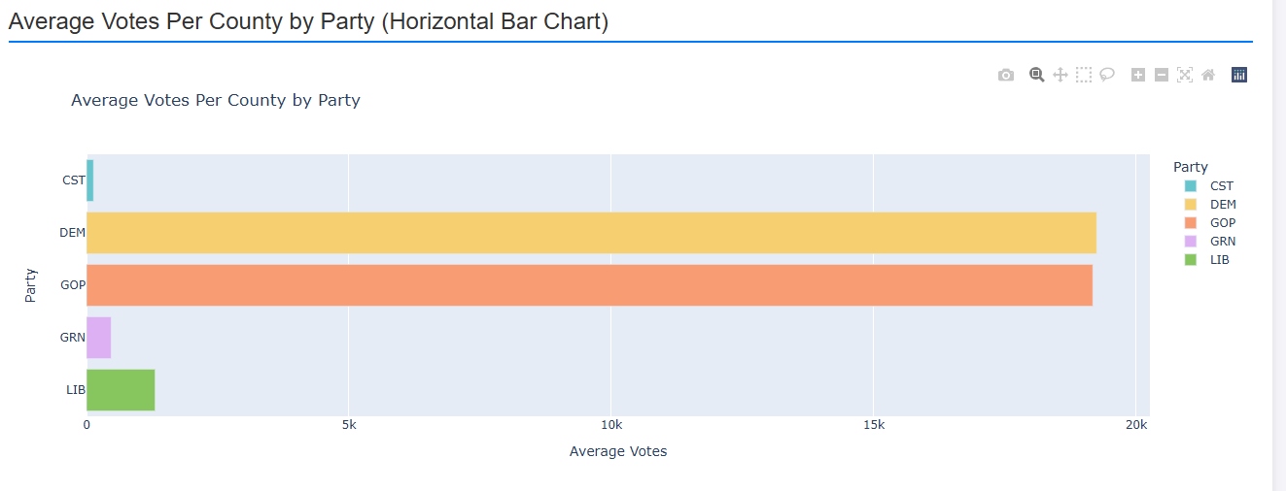

Slide 19
Key Insights derived
Trump’s wider hold: Even though Clinton won more votes in total, Trump won the greatest number of counties. This shows that Clinton needs to focus more widely rather than intense focus only on few specific counties,
Trump's focus on swing states yielded higher margins in critical states like Florida and Pennsylvania: Democrats should increase campaign efforts in swing states, balancing between urban and suburban areas.
Clinton won more urban counties, while Trump dominated rural counties: This indicates that Democrats need to extend their reach into rural areas, as urban support alone is insufficient for securing electoral victories.
Clinton's lead in states like California and New York didn't translate into Electoral College success: To win future elections, Democrats must concentrate on battleground states rather than states they traditionally dominate.

Slide 20
Key Insights derived
Impact of Third Parties: In states like Wisconsin, third-party candidates (e.g., Libertarian and Green Party) garnered a significant percentage of votes, possibly impacting Clinton's loss. Both major parties should address issues attracting third-party voters to capture this segment.
Rust Belt States Shift: Trump won key states like Michigan, Wisconsin, and Pennsylvania by small margins, flipping them from previous Democratic victories. Democrats need to focus on addressing local economic concerns, especially manufacturing and employment.

Slide 21
Key Insights derived
Counties with higher voter margins for Trump often had fewer registered voters overall: Clinton's campaign should invest in voter registration drives in low-turnout counties to increase the voter base.
Clinton underperformed in counties where third-party candidates had a higher vote share: Strategies to win over third-party voters or undecideds could make a critical difference in close races.
State-Level Action: Focus campaigns in swing and emerging battleground states (e.g., Arizona, Georgia, and Wisconsin).
County-Level Action: Prioritize outreach in high-vote and swing counties while boosting turnout in low-participation areas.
Third-Party Action: Tailor policies to win over Libertarian and Green Party voters, especially in states with close margins.

